Slide 1
Outline
Task Table for Routing Induced Deadlock
Sufficient Condition for Routing Induced Deadlock
Special Routing Induced Deadlock Case

Slide 2
Task Table for Routing Induced Deadlock

Slide 3
Task Table for Routing Induced Deadlock
Loop induced deadlock | Sufficient condition: packet injection rate is larger than the maximum packet drain rate caused by TTL expiration; | Completed
 | Deadlock creation time: 1) estimation of deadlock creation time: m/r_{in}; 2) Measurement of deadlock creation time (a few milliseconds); | Completed
Cyclic routing dependency induced deadlock | Sufficient condition: there is a cycle in the dependency graph of congestion queue. | Completed last week
 | Deadlock creation time: NS-3 Simulation and testbed experiments. | Not completed

Slide 4
Sufficient Condition for Routing Induced Deadlock

Slide 5
Sufficient Condition for Routing Induced Deadlock
Congestion Queue (CQ)
Definition
Cascade Effect
Conditions for Identifying CQ:
Capacity Bounded
Head-Of-Line (HOL) blocking bounded
Preliminary Model Based on CQ and Fluid Model
Notation
Assumption
Static Shaping Rate of CQ
Static PFC Threshold
Sufficient Condition
Dependency Graph of CQ
Iterative Computation of CQ
Construction of Dependent Edges between CQs

Slide 6
Outline
Sufficient Condition for Routing Induced Deadlock
Congestion Queue (CQ)
Definition
Cascade Effect
Conditions for Identifying CQ:
Capacity Bounded
Head-Of-Line (HOL) blocking bounded
Preliminary Model Based on CQ and Fluid Model
Notation
Assumption
Static Shaping Rate of CQ
Static PFC Threshold
Sufficient Condition
Dependency Graph of CQ
Iterative Computation of CQ
Construction of Dependent Edges between CQs

Slide 7
Definition of Congestion Queue
flows
pause
…
switch egress queue
Definition of congestion queue (CQ): if a device generates PFC PAUSE frames to pause its upstream devices due to the packet queuing in a switch egress queue, we say this egress queue is a congestion queue.

Slide 8
Cascade effect of Congestion Queue
Step-1:
flow 2
r₂
A
rx
tx
r^{c}
r^{c}
r₁
r₃
flow 1
B
C
tx
rx
rx
flow 3
tx
The tx queue of switch B is a CQ, and rates of flow 1 and flow 3 are shaped into r^{c} at switch B (r_{1,} r₃ > r^{c}).

Slide 9
Cascade effect of Congestion Queue
Step-2:
flow 2
r₂
A
rx
tx
r^{c}
r^{c}
r₁
r₃
flow 1
B
C
tx
r^{c}
rx
rx
flow 3
tx
r^{c}
The tx queue of switch C becomes a new CQ due to PFC pause, and rates of flow 2 and flow 3 are shaped into r^{c} at switch C (r_{2,} r₃ > r^{c}).

Slide 10
Cascade effect of Congestion Queue
Step-3:
flow 2
r₂
A
r^{c}
rx
tx
r^{c}
r^{c}
r₁
r₃
flow 1
B
C
tx
r^{c}
rx
rx
flow 3
tx
r^{c}
The tx queue of switch A becomes a new CQ due to PFC pause, and rates of flow 1 are shaped into r^{c} at switch A (r₁ > r_{c}).

Slide 11
Cascade effect of Congestion Queue
Step-4:
flow 2
r₂
A
r^{c}
rx
tx
r^{c}
r^{c}
r₁
r₃
flow 1
B
C
tx
r^{c}
rx
rx
flow 3
tx
r^{c}
A deadlock is created due to the cyclic dependency among three CQs.

Slide 12
Cascade effect of Congestion Queue
r₁ = r_{f}
r₂ = r^{c}_{q}
flow f
q₁
q₂
r₁ = r_{f}
r₂ = r^{c}_{q}
flow f
pause
q₁
q₂
Cascade effect of CQ: once a flow is shaped at one CQ, the upstream egress queue this flow traverses will become a new CQ later due to PFC pause.

Slide 13
Conditions for Identifying CQ
Condition-1 (capacity bounded): an egress queue becomes CQ when its capacity cannot serve the traffic of all the flows traversing it.
Condition-2 (head-of-line blocking bounded): an egress queue becomes CQ when some flows traversing it are paused by some downstream CQ.
f₁
> 40Gbps
=40Gbps
pause
f₂
…
f_{n}
q
pause
pause
f₁
5Gbps
…
1Gbps
f₂
…
f_{n}
q₁ (type-2)
q₂ (type-1)

Slide 14
Outline
Sufficient Condition for Routing Induced Deadlock
Congestion Queue (CQ)
Definition
Cascade Effect
Conditions for Identifying CQ:
Capacity Bounded
Head-Of-Line (HOL) blocking bounded
Preliminary Model Based on CQ and Fluid Model
Notation
Assumption
Static Shaping Rate of CQ
Static PFC Threshold
Sufficient Condition
Dependency Graph of CQ
Iterative Computation of CQ
Construction of Dependent Edges between CQs

Slide 15
Fluid model - Notation
N = (V, E) | A lossless output-queued network, where V is the set of switches and E is the set of links .
F = {f₁, f₂, …, f_{n}} | The set of flows transmitted in N.
R = {r_{f1}, r_{f2}, …, r_{fn}} | Here r_{fi} is the injection rate of flow f_{i}.
Q = {q₁,q₂,… ,q_{m}} | The set of egress queues of all switches in V.
Q_{c}= {q₁,q₂,… ,q_{k}} | The set of congestion queues, Q_{c}⊆Q.
f₂
r₂
A
V={A, B, C}, E= {e_{A,B}, e_{B,C}, e_{C,A}}
F = {f₁, f₂, f₃}, R = {r₁, r₂, r₃}
Q = {q₁, q₂, q₃,…}, Q_{c} = {q₁}
rx
tx
q₃
r₁
q₁
f₁
q₂
B
C
f₃
tx
rx
rx
tx
r₃

Slide 16
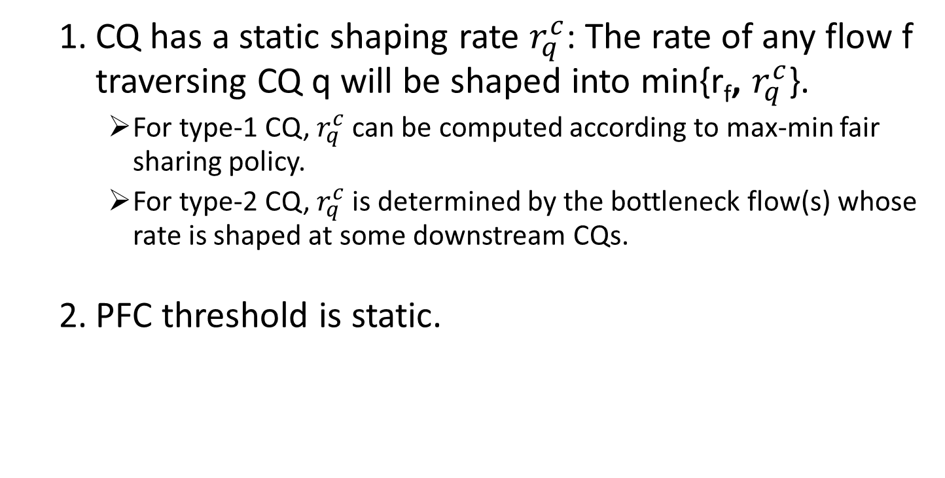
Fluid model - Assumption
CQ has a static shaping rate $r_{q}^{c}$: The rate of any flow f traversing CQ q will be shaped into min{r_{f}, $r_{q}^{c}$}.
For type-1 CQ, $r_{q}^{c}$ can be computed according to max-min fair sharing policy.
For type-2 CQ, $r_{q}^{c}$ is determined by the bottleneck flow(s) whose rate is shaped at some downstream CQs.
PFC threshold is static.

Slide 17
Outline
Sufficient Condition for Routing Induced Deadlock
Congestion Queue (CQ)
Definition
Cascade Effect
Conditions for Identifying CQ:
Capacity Bounded
Head-Of-Line (HOL) blocking bounded
Preliminary Model Based on CQ and Fluid Model
Notation
Assumption
Static Shaping Rate of CQ
Static PFC Threshold
Sufficient Condition
Dependency Graph of CQ
Iterative Computation of CQ
Construction of Dependent Edges between CQs

Slide 18
Iterative Computation of Congestion Queue
Given N, F, Q and a CQ q₀, we can get Q_{c} with a iterative computation as below:
Initialization: (1) Q_{c} = {q₀}; (2) ∀𝑓∈𝐹, set f’s output rate at all traversing egress queues as its injection rate.
flow 2
r₂
A
Step-1: ∀𝑞∈Q_{c}, perform rate shaping for all flows traversing q.
rx
tx
r₁
r₂
r₁
r₃
Step-2: compute static shaping rates for new congestion queues, and add them into Q_{c ;}
flow 1
r₁
r₃
r₃
B
C
tx
rx
rx
tx
r₂
flow 3
∃𝑞∈Q_{c}, q has some flows to shape?
Yes
Q_{c} = {B-tx};
No
Output Q_{c};

Slide 19
Iterative Computation of Congestion Queue
Given N, F, Q and a CQ q₀, we can get Q_{c} with a iterative computation as below:
Initialization: (1) Q_{c} = {q₀}; (2) ∀𝑓∈𝐹, set f’s output rate at all traversing egress queues as its injection rate.
flow 2
r₂
A
Step-1: ∀𝑞∈Q_{c}, perform rate shaping for all flows traversing q.
rx
tx
r₁
r₂
r^{c}
r^{c}
Step-2: compute static shaping rates for new congestion queues, and add them into Q_{c ;}
flow 1
r₁
r₃
r₃
B
C
tx
rx
rx
tx
r₂
flow 3
∃𝑞∈Q_{c}, q has some flows to shape?
Yes
Q_{c} = {B-tx};
No
Output Q_{c};

Slide 20
Iterative Computation of Congestion Queue
Given N, F, Q and a CQ q₀, we can get Q_{c} with a iterative computation as below:
Initialization: (1) Q_{c} = {q₀}; (2) ∀𝑓∈𝐹, set f’s output rate at all traversing egress queues as its injection rate.
flow 2
r₂
A
Step-1: ∀𝑞∈Q_{c}, perform rate shaping for all flows traversing q.
rx
tx
r₁
r₂
r^{c}
r^{c}
Step-2: compute static shaping rates for new congestion queues, and add them into Q_{c ;}
flow 1
r₁
r₃
r₃
B
C
tx
rx
rx
tx
r₂
flow 3
∃𝑞∈Q_{c}, q has some flows to shape?
Yes
Q_{c} = {B-tx, C-tx};
No
Output Q_{c};

Slide 21
Iterative Computation of Congestion Queue
Given N, F, Q and a CQ q₀, we can get Q_{c} with a iterative computation as below:
Initialization: (1) Q_{c} = {q₀}; (2) ∀𝑓∈𝐹, set f’s output rate at all traversing egress queues as its injection rate.
flow 2
r₂
A
Step-1: ∀𝑞∈Q_{c}, perform rate shaping for all flows traversing q.
rx
tx
r₁
r₂
r^{c}
r^{c}
Step-2: compute static shaping rates for new congestion queues, and add them into Q_{c ;}
flow 1
r₁
r₃
r₃
B
C
tx
rx
rx
tx
r₂
flow 3
∃𝑞∈Q_{c}, q has some flows to shape?
Yes
Q_{c} = {B-tx, C-tx};
No
Output Q_{c};

Slide 22
Iterative Computation of Congestion Queue
Given N, F, Q and a CQ q₀, we can get Q_{c} with a iterative computation as below:
Initialization: (1) Q_{c} = {q₀}; (2) ∀𝑓∈𝐹, set f’s output rate at all traversing egress queues as its injection rate.
flow 2
r^{c}
A
Step-1: ∀𝑞∈Q_{c}, perform rate shaping for all flows traversing q.
rx
tx
r^{c}
r^{c}
r^{c}
r^{c}
Step-2: compute static shaping rates for new congestion queues, and add them into Q_{c ;}
flow 1
r^{c}
r^{c}
r^{c}
B
C
tx
rx
rx
tx
r^{c}
flow 3
∃𝑞∈Q_{c}, q has some flows to shape?
Yes
Q_{c} = {B-tx, C-tx, A-tx};
No
Output Q_{c};

Slide 23


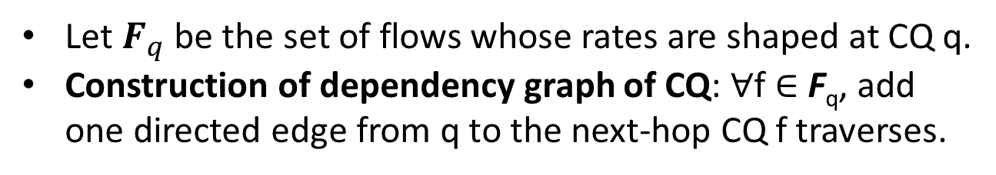

Dependency Graph of Congestion Queue
flow 2
flow 2
$F_{q}$={f2}
A
rx
tx
$F_{q}$={f1, f3}
flow 3
flow 1
B
C
tx
rx
flow 3
$F_{q}$={f2, f3}
rx
tx
flow 1
Topology and flows
Dependency graph of CQ
Let $F_{q}$ be the set of flows whose rates are shaped at CQ q.
Construction of dependency graph of CQ: ∀f ∈ F_{q}, add one directed edge from q to the next-hop CQ f traverses.

Slide 24
Sufficient Condition for Deadlock Creation
Sufficient condition for deadlock creation: there is a cycle in the dependency graph of CQ.
Proof: Suppose there is a cycle in the dependency graph of CQ. For any CQ in the cycle, It will pause its upstream CQ in the cycle While at the same time being paused by its downstream CQ in the cycle. As no packets can get moved in the cycle, a deadlock is created.

Slide 25
Special Routing induced Deadlock Case

Slide 26

Special Routing induced Deadlock Case
Step 1:
r₁ (> 500Mbps)
S1
S2
Flow 1
tx
rx
rx
tx
tx-1
rx
$F_{q}$={f1}
S4
S3
500Mbps
tx-2
rx
tx
Rate limiting = 500Mbps
The tx queue of switch S4 is a CQ with static shaping rate 500Mbps, and rate of flow 1 are shaped into 500Mbps at switch S4.

Slide 27



Special Routing induced Deadlock Case
Step 2:
r₁ (> 500Mbps)
S1
$F_{q}$={f1}
S2
Flow 1
tx
rx
rx
500Mbps
tx
$F_{q}$={f1}
500Mbps
tx-1
500Mbps
rx
$F_{q}$={f1}
S4
S3
500Mbps
tx-2
rx
tx
Rate limiting = 500Mbps
$F_{q}$={f1}
The tx queues of switch S1, S2 and S3 become new CQs due to PFC pause, and rates of flow 1 are shaped into 500Mbps at these three switches.

Slide 28

Special Routing induced Deadlock Case
Step 3:
r₁ (> 500Mbps)
S1
$F_{q}$={f1}
S2
Flow 1
tx
rx
500Mbps
rx
500Mbps
tx
500Mbps
$F_{q}$={f1}
500Mbps
r₂ > 500Mbps
tx-1
500Mbps
rx
$F_{q}$={f1}
S4
S3
Flow 2
500Mbps
tx-2
rx
tx
Rate limiting = 500Mbps
$F_{q}$={f1, f2}
The rate of flow 1 is shaped into 500Mbps at switch S3.

Slide 29




Special Routing induced Deadlock Case
Dependency graph of CQ:
$F_{q}$={f1}
$F_{q}$={f1}
$F_{q}$={f1}
$F_{q}$={f1, f2}
There should be no deadlock as no cycle in the dependency graph of CQ.

Slide 30
Special Routing induced Deadlock Case
r₁ (> 500Mbps)
S1
$F_{q}$={f1}
S2
Flow 1
tx
rx
300Mbps
rx
360Mbps
tx
500Mbps
$F_{q}$={f1}
r₂ =4Gbps
tx-1
rx
$F_{q}$={f1}
S4
S3
Flow 2
tx-2
rx
tx
Rate limiting = 500Mbps
$F_{q}$={f1, f2}
Testbed measurement: deadlock occurs when r₂ = 4Gbps. We found that rate of flow 2 is further shaped into 300Mbps at switch S1.

